Slide 1
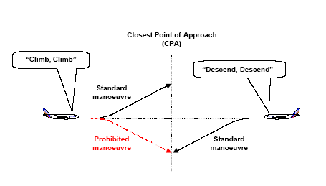

Slide 2
ACAS can issue two types of alert:
Traffic Advisories (TAs), which aim at helping the pilot in the visual search for the intruder aircraft, and by alerting him to be ready for a potential resolution advisory;
Resolution Advisories (RAs), which are avoidance manoeuvres recommended to the pilot. When the intruder aircraft is also fitted with an ACAS system, both ACAS’ co-ordinate their RAs through the Mode S data link, in order to select complementary resolution senses.

